Slide 1




Next Gen Employability Program
Full Stack Web Development with AI Tools
Team Details – Team ID – NG_CP_Team_5157
C. Praneeth Kumar
B. Rahul
MD. Mujeeb
K. Devikarani
B. Satya Sekhar
22N81A6720
22N81A6297
23N85A0503
22N81A0508
22N81A66F9
College: Sphoorthy Engineering College

Slide 2

The content is curated from online/offline resources and used for educational purpose only.
Notes:
Speaker would be briefing the students that this content has been prepared for the educational purpose only and is referred from multiple sites which are cited in the last.​​
---------------------------------------------------​​
A disclaimer is a statement or notice that is intended to clarify, limit, or provide information about the scope, limitations, or potential risks associated with certain actions, information, products, services, or content. ​​
​​
​

Slide 3

Project Title
Student Complaint Management System with SLA Tracking
Notes:
In this slide speaker will be introducing the program and its outcomes. The speaker will introduce himself in brief

Slide 4

Table of Contents
Introduction
Problem Statement
Solution
Technologies used
Features
Screenshots
References
Notes:
This slide, The speaker will talk about the content that we will be covering in this session as follows:
Introduction
Importance of UI/UX in industry
History and Definitions of UI and UX
Key Differences between UI/UX
Use Cases
Significance in Web Development
Use Cases
Visual Design Principles
Design process
Color theory and psychology
Typography and readability
Layout and Spacing
Responsive design basics
Usability and Accessibility
Usability Aspects
Web Content Accessibility Guidelines (WCAG)
Inclusive design practices
Consistency
User Experience
User-Centered Design
User research methods
Interactive Elements and Feedback
Mini Case Study
Discussing a popular UI/UX design
Hands-On
Introduction to Figma for UI/UX design

Slide 5
Introduction
A Complaint Management System with SLA Tracking is a software application used to register, track, and resolve complaints efficiently. It helps organizations manage complaints in an organized manner instead of using manual methods.
The system assigns a fixed time limit (SLA) for resolving each complaint and continuously monitors the progress. This ensures faster resolution, better transparency, and improved customer satisfaction. It also provides automated alerts and escalation when SLA deadlines are about to be missed, ensuring accountability.
Notes:
This slide, The speaker will talk about the content that we will be covering in this session as follows:
Introduction
Importance of UI/UX in industry
History and Definitions of UI and UX
Key Differences between UI/UX
Use Cases
Significance in Web Development
Use Cases
Visual Design Principles
Design process
Color theory and psychology
Typography and readability
Layout and Spacing
Responsive design basics
Usability and Accessibility
Usability Aspects
Web Content Accessibility Guidelines (WCAG)
Inclusive design practices
Consistency
User Experience
User-Centered Design
User research methods
Interactive Elements and Feedback
Mini Case Study
Discussing a popular UI/UX design
Hands-On
Introduction to Figma for UI/UX design

Slide 6
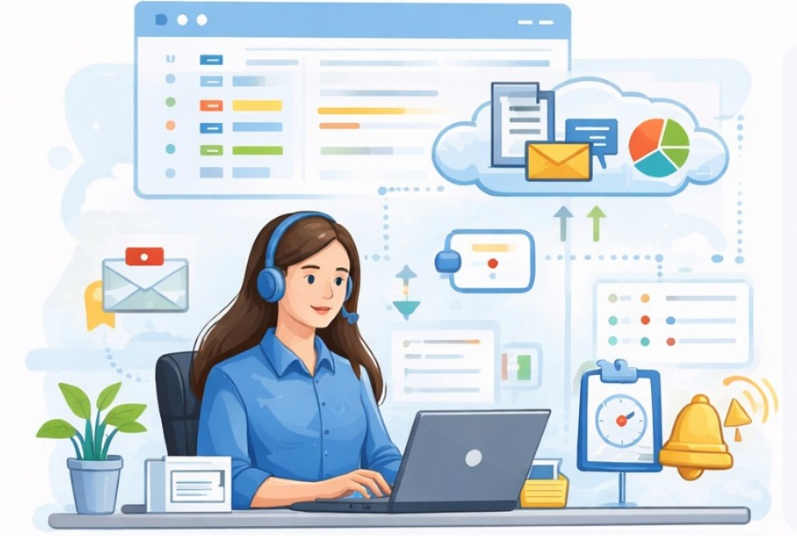
Problem Statement
Educational institutions often struggle with inefficient student complaint management, leading to delayed resolutions, lack of accountability, and poor user satisfaction. Manual processes result in lost complaints, uneven workload distribution, and missed service level agreements (SLAs). This creates frustration for students and staff, hindering institutional trust and operational efficiency.
Notes:
This slide, The speaker will talk about the content that we will be covering in this session as follows:
Introduction
Importance of UI/UX in industry
History and Definitions of UI and UX
Key Differences between UI/UX
Use Cases
Significance in Web Development
Use Cases
Visual Design Principles
Design process
Color theory and psychology
Typography and readability
Layout and Spacing
Responsive design basics
Usability and Accessibility
Usability Aspects
Web Content Accessibility Guidelines (WCAG)
Inclusive design practices
Consistency
User Experience
User-Centered Design
User research methods
Interactive Elements and Feedback
Mini Case Study
Discussing a popular UI/UX design
Hands-On
Introduction to Figma for UI/UX design

Slide 7
Proposed Solution
The system design was inspired by existing grievance redressal and ticketing platforms such as Helpdesk and public grievance portals, while implementing a simplified, ‘role-based architecture suitable for academic environments’
Develop a “Web-based Student Complaint Management System”.
Users can register complaints online.
Each complaint is assigned an “SLA time limit”.
Automatic tracking of complaint status.
Alerts and notifications before SLA breach.
Admin dashboard to monitor complaint performance.
Notes:
This slide, The speaker will talk about the content that we will be covering in this session as follows:
Introduction
Importance of UI/UX in industry
History and Definitions of UI and UX
Key Differences between UI/UX
Use Cases
Significance in Web Development
Use Cases
Visual Design Principles
Design process
Color theory and psychology
Typography and readability
Layout and Spacing
Responsive design basics
Usability and Accessibility
Usability Aspects
Web Content Accessibility Guidelines (WCAG)
Inclusive design practices
Consistency
User Experience
User-Centered Design
User research methods
Interactive Elements and Feedback
Mini Case Study
Discussing a popular UI/UX design
Hands-On
Introduction to Figma for UI/UX design

Slide 8
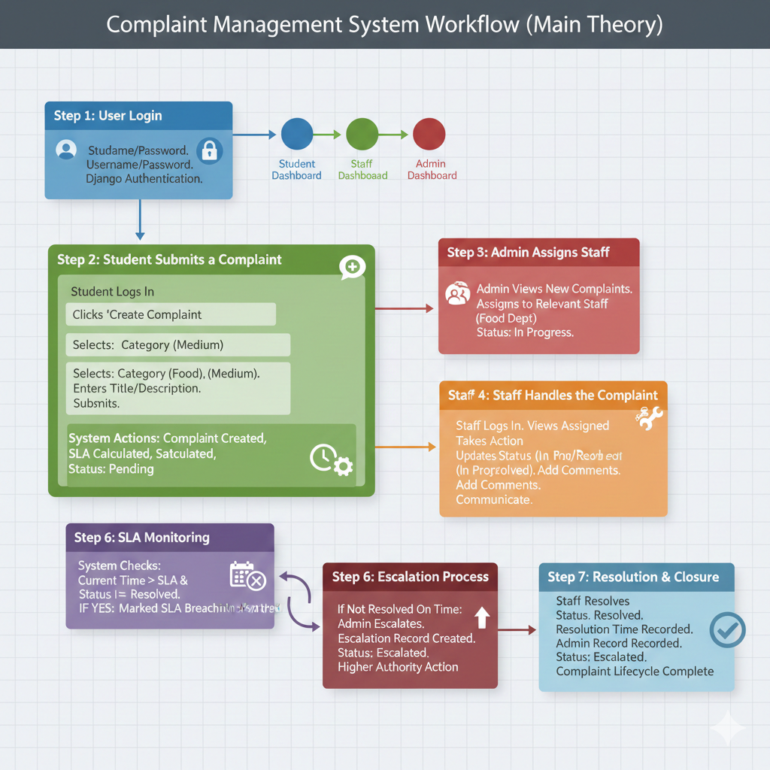
Fig 1: Complaint Management System Work Flow

Slide 9
Technologies Used
Frontend
HTML
CSS
JavaScript
Bootstrap
Backend
Django (Python)
Database
SQLite3
Authentication
Django Custom User Model
Other Tools
Git for version control

Slide 10
Key Features
User registration and login.
Complaint submission with category and priority.
SLA-based deadline assignment.
Complaint status tracking.
Automatic SLA alerts and notifications.
Admin dashboard with reports.
Complaint history and analytics.

Slide 11
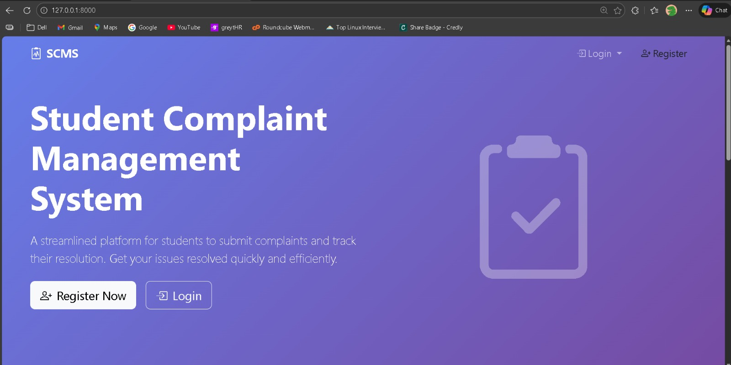
Fig 2: Complaint Management System Portal

Slide 12
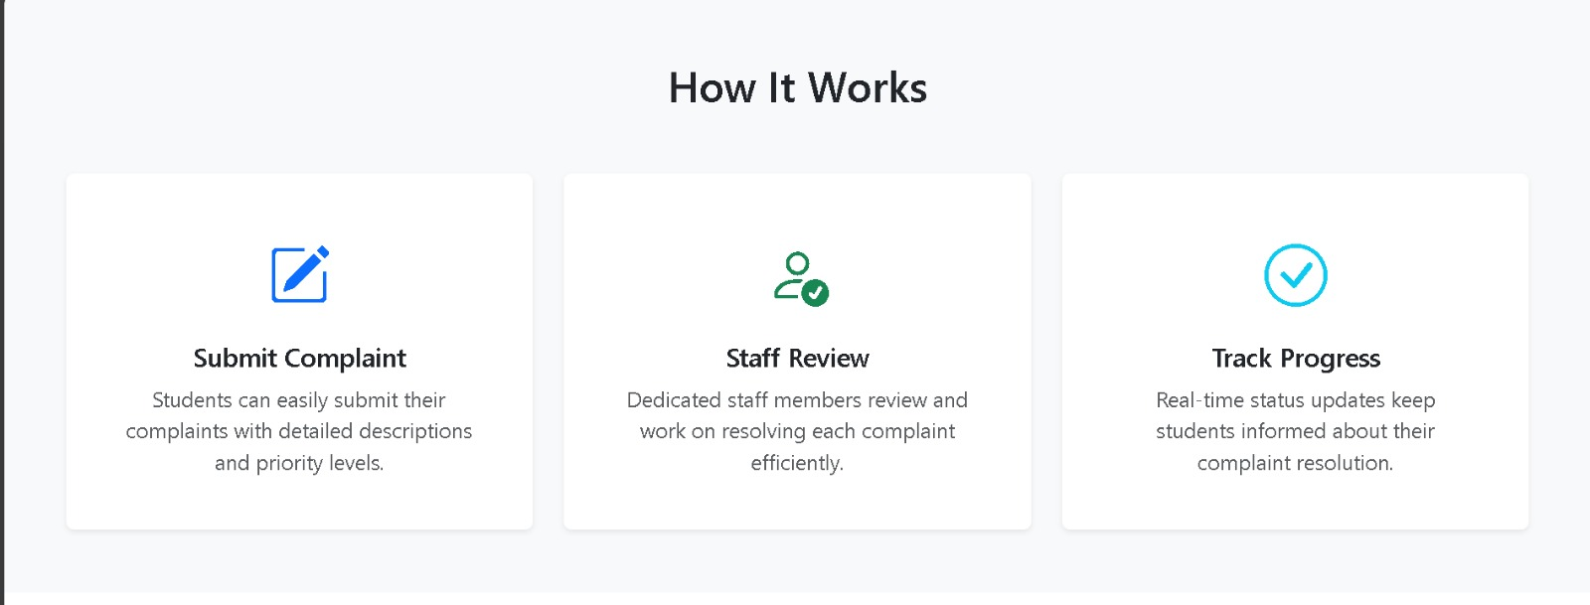
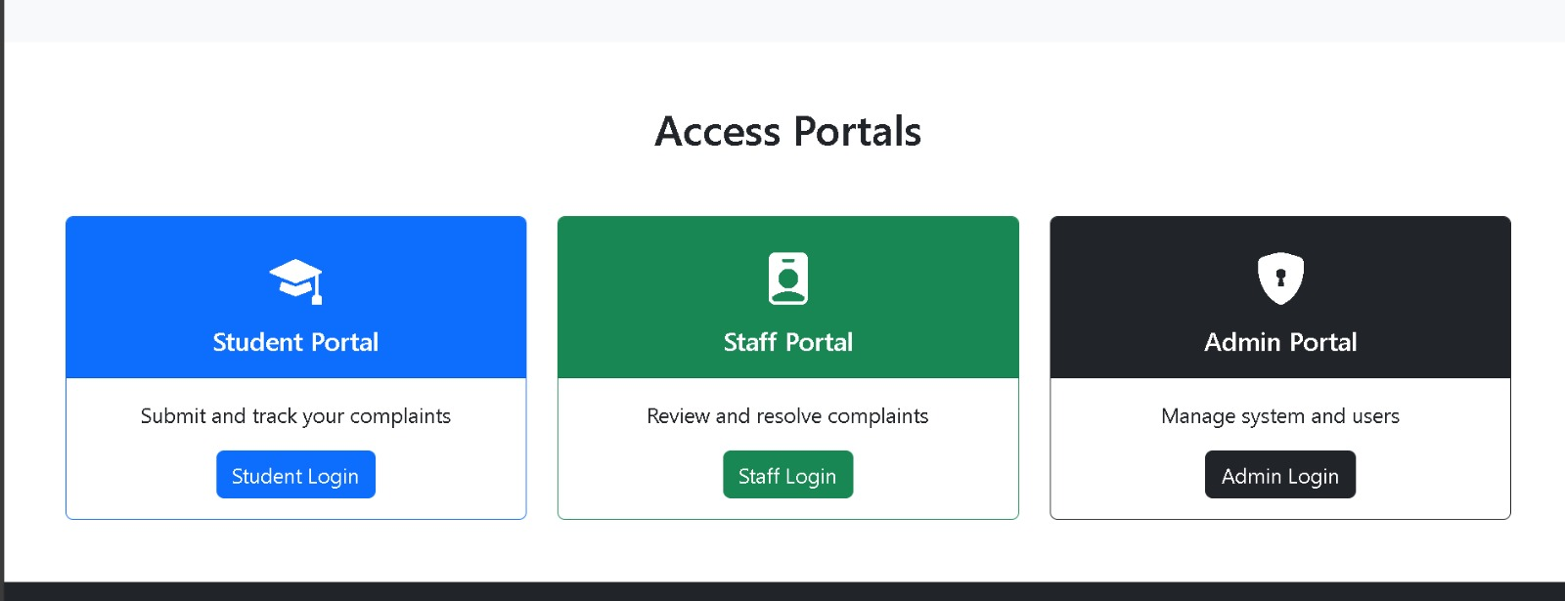
Fig 3: How Our Portal Works…..& User Roles(Student, Staff, Admin)

Slide 13
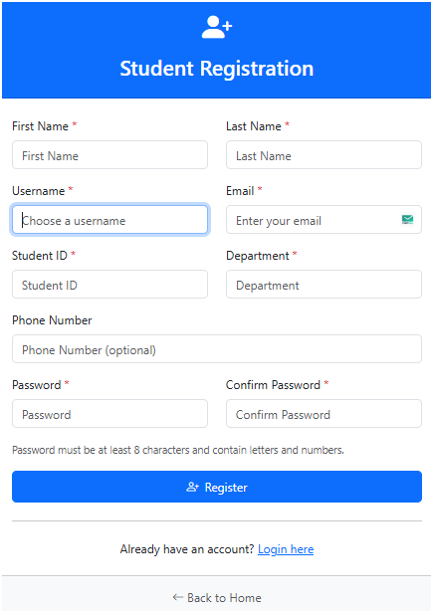
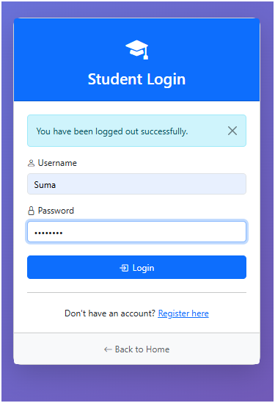
Fig 4: Student Registration
Fig 5: Student Login

Slide 14
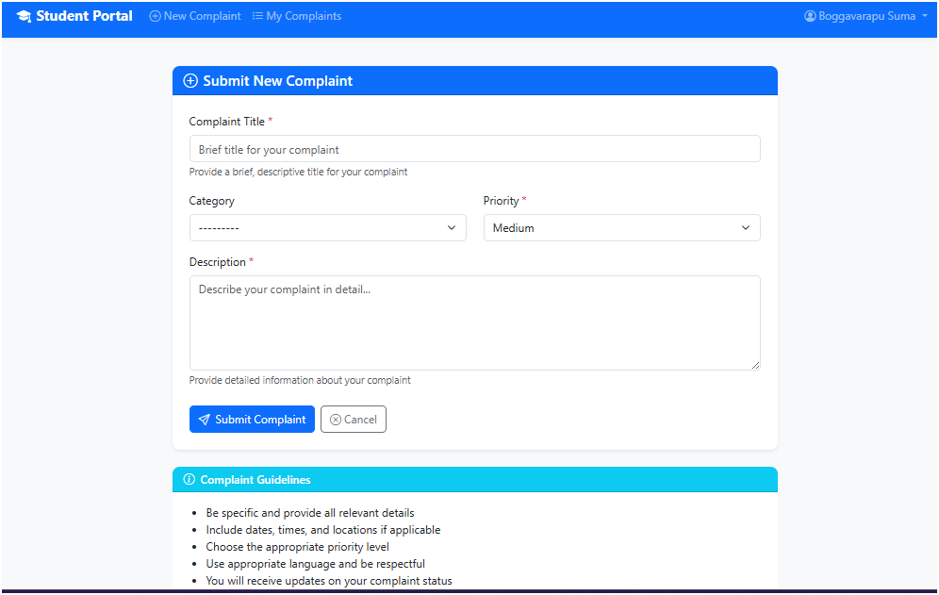
Fig 6: Submit Complaint from Student Side

Slide 15
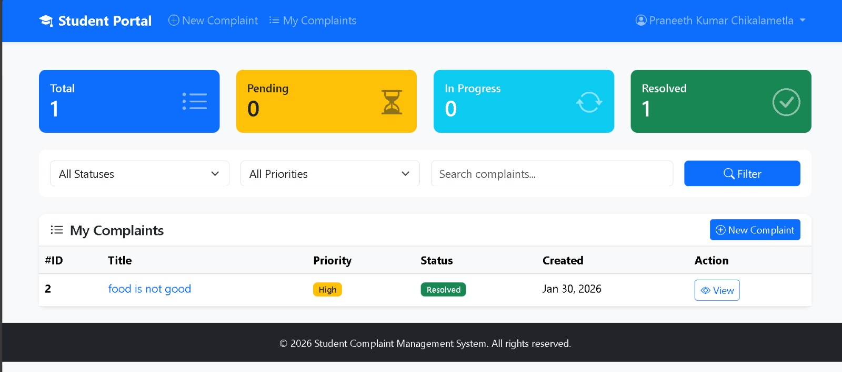
Fig 7: Viewable Student Status

Slide 16
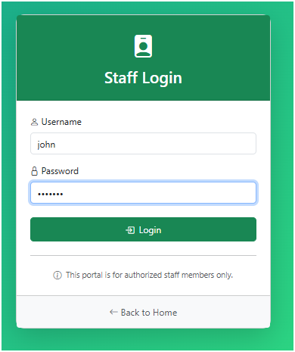
Fig 8: Staff Login

Slide 17
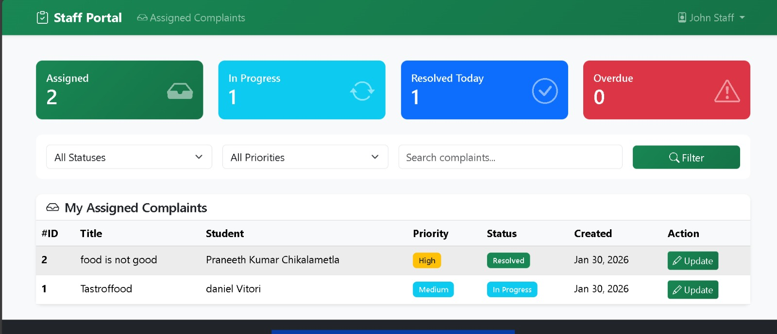
Fig 9: Viewable Staff Portal

Slide 18
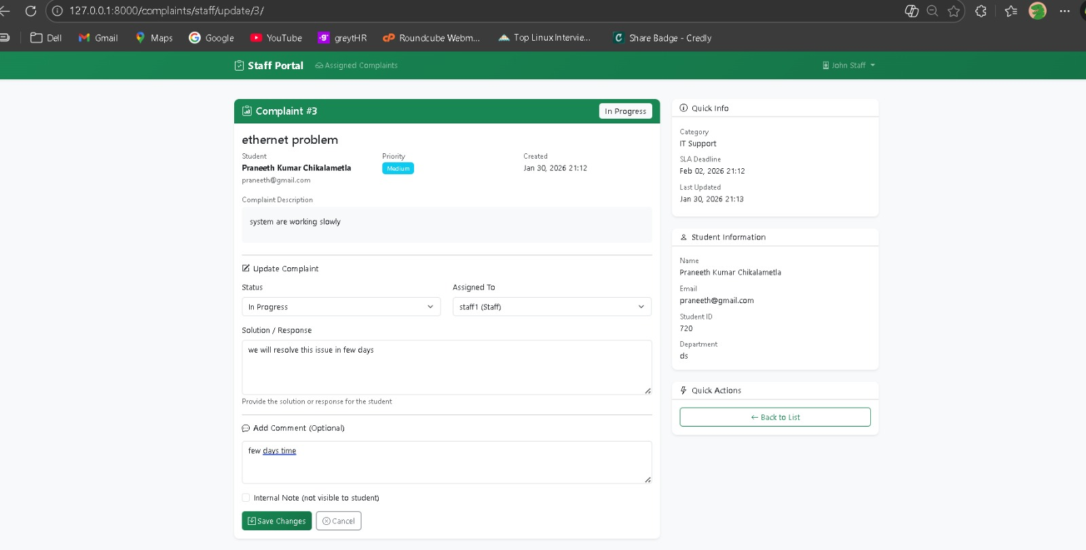
Fig 10: Staff Complaint Progress

Slide 19
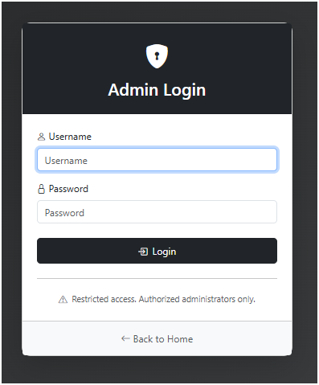
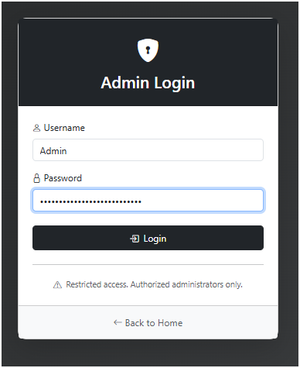
Fig 12: Admin Login Credentials
Fig 11: Admin Login

Slide 20
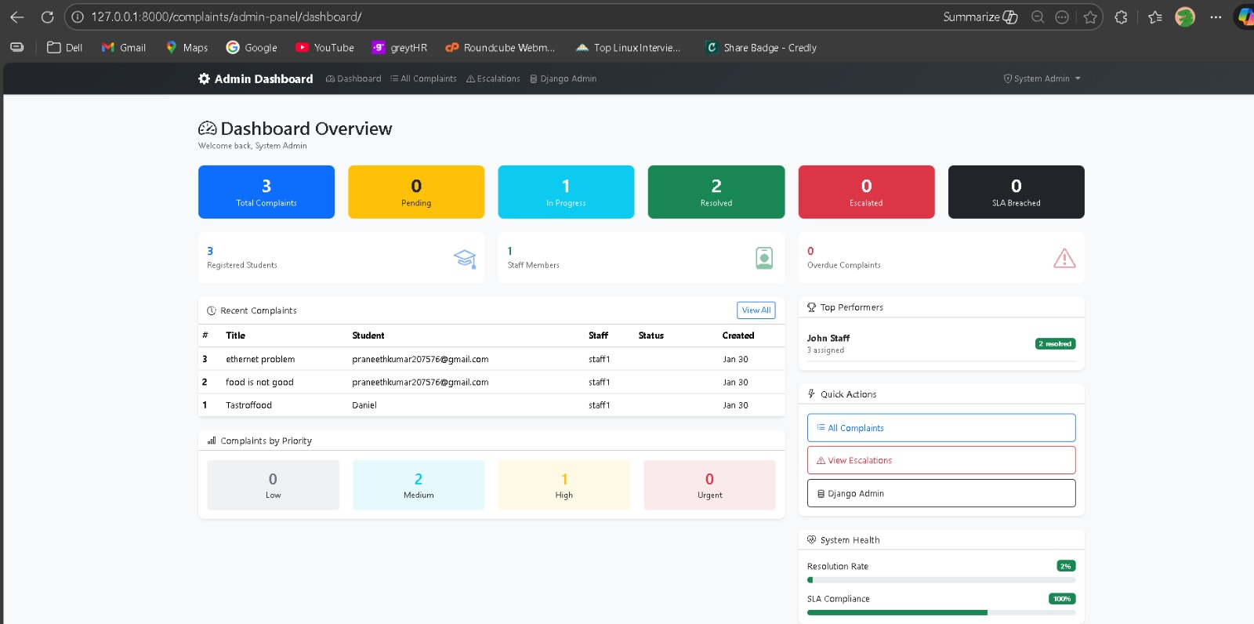
Fig 13: Admin Dashboard

Slide 21
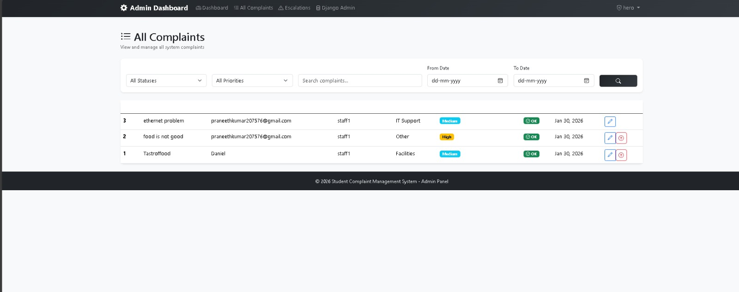
Fig 14: Viewable Complaints Admin Can Lookonto

Slide 22
References
Django Helpdesk (Industry-grade ticket system)
🔗 https://github.com/django-helpdesk/django-helpdesk
Public Grievance Redressal System (India – Concept)
🔗 https://pgportal.gov.in
Django Ticket System
🔗 https://github.com/search?q=django+ticket+system&type=repositories
Complaint Management System
🔗 https://github.com/topics/complaint-management-system-django
Django Role-Based Authentication Example
🔗 https://github.com/vintasoftware/django-role-permissions

